Slide 1

Smart Waste Management System
Using IBM Watson Services
-Team Pochinki
Madisetty Eshwar
Gowtham Mohan
Kolluru Sri Harsha

Slide 2

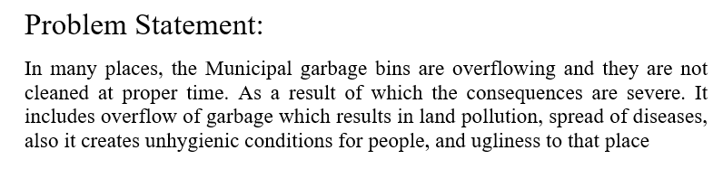

Slide 3

OBJECTIVE
To develop a smart garbage bin which will intimate the particular authority, if the garbage bin is about to fill full.

Slide 4
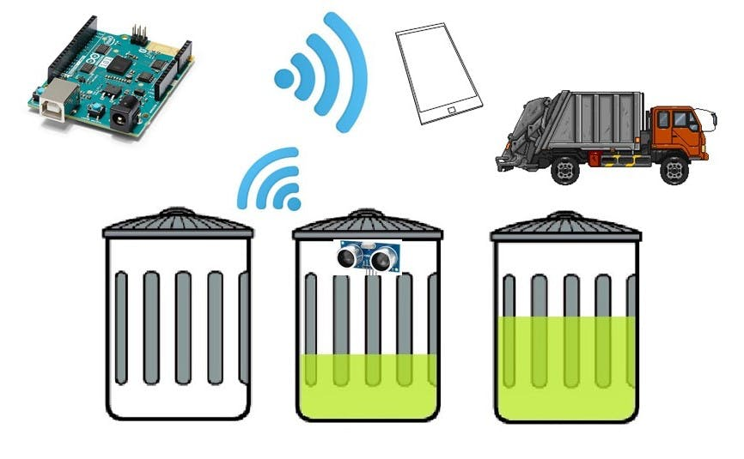

Slide 5

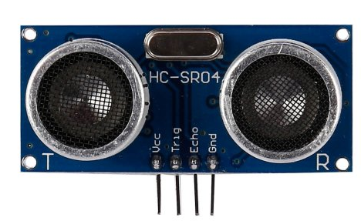
Module 1-Sensor
Ultrasonic sensor
HC-SR04 Sensor Features
Operating voltage: +5V
Theoretical Measuring Distance: 2cm to 450cm
Practical Measuring Distance: 2cm to 80cm
Accuracy: 3mm
Measuring angle covered: <15°
Operating Current: <15mA
Operating Frequency: 40Hz

Slide 6

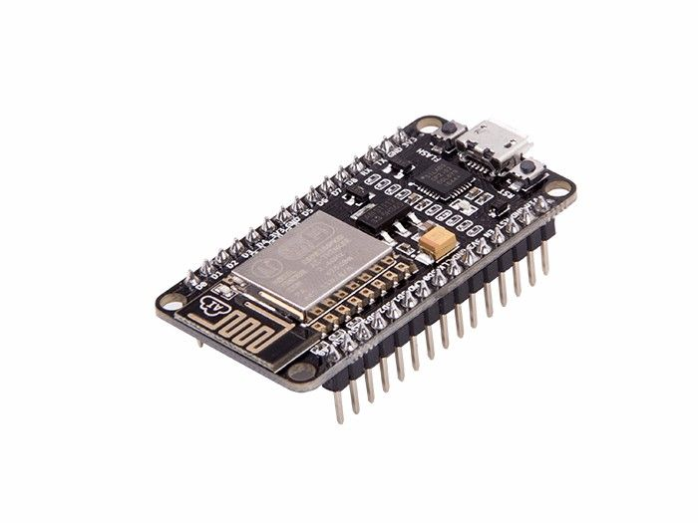
Module 2 - Microcontroller
NodeMcu-ESP8266
Features
*Arduino-like (software defined) hardware IO.
*Can be programmed with the simple and powerful Lua programming language or Arduino IDE.
*USB-TTL included, plug & play.
*10 GPIOs D0-D10, PWM functionality, IIC and SPI communication, 1-Wire and ADC A0 etc. all in one board.
*Wifi networking (can be used as access point and/or station, host a web server), connect to internet to fetch or upload data.
*Event-driven API for network applications.
*PCB antenna.

Slide 7

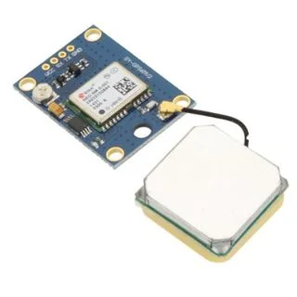
Module 3-Location tracket
GPS Module: GY-GPS6MU2
Features:
5Hz position update rate
Operating temperature range: -40 TO 85°CUART TTL socket
EEPROM to save configuration settings
Rechargeable battery for Backup
The cold start time of 38 s and Hot start time of 1 s
Supply voltage: 3.3 V
Configurable from 4800 Baud to 115200 Baud rates. (default 9600)
SuperSense ® Indoor GPS: -162 dBm tracking sensitivity
Support SBAS (WAAS, EGNOS, MSAS, GAGAN.

Slide 8

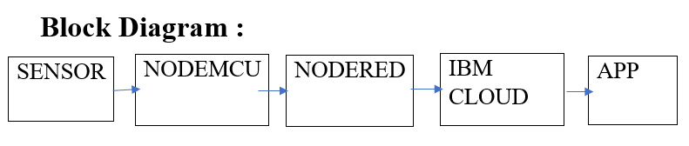

Slide 9

Future scope:
This project being a part of IOT, may be influential in many ways like in the field of agriculture and water related technical works. This smart garbage bin helps authorities to clean the garbage as soon as possible so that we can avoid unhealthy environments and prevents pollution.
Conclusion:
By designing the Smart Garbage Bin we could able to clean the garbage on time by avoiding it from over flow and maintain a healthy environment. Thereby we can prevent the diseases which are produced due to overflow of garbage bins.

Slide 10
